Slide 1
Finite automata
Chapter-2

Slide 2
contents
Examples of DFA design
DFA minimization

Slide 3
Examples of DFA
Example 1: Design a DFA to accept strings over Ʃ={a,b} with length exactly n.
When n is exactly 2
When n is exactly 3
a,b
Start
a,b
a,b
a,b
S₀
S₁
S₂
ɸ
a,b
Start
a,b
a,b
a,b
a,b
S₀
S₁
S₂
S₃
ɸ

Slide 4
Contd..
For exactly 2, Total number of states= 4, that is 2+2.
That is 2+2, where the first 2 is the length of the strings and the last 2 for empty string and dead state.
For exactly 3, total number of states=5, that is 3+2
Therefore, for exactly n, the total number of states will be n+2.
a,b
Start
a,b
a,b
a,b
a,b
a,b
S₀
S₁
S₂
…
S_{n}
ɸ

Slide 5
Examples of DFA
Example 2: Design a DFA to accept strings over Ʃ={a,b} with length at least n.
When n is at least 2
When n is exactly 3
a,b
Start
a,b
a,b
S₀
S₁
S₂
a,b
Start
a,b
a,b
a,b
S₀
S₁
S₂
S₃

Slide 6
Contd..
For at least 2, Total number of states= 3, that is 2+1.
That is 2+2, where the first 2 is the length of the strings and 1 is for empty string.
For at least 3, total number of states=4, that is 3+1
Therefore, for at least n, the total number of states will be n+1.
a,b
Start
a,b
a,b
a,b
a,b
…
S₀
S₁
S₂
S_{n}

Slide 7
Examples of DFA
Example 3: Design a DFA to accept strings over Ʃ={a,b} with length at most n.
When n is at most 2
When n is at most 3
a,b
Start
a,b
a,b
a,b
S₀
S₁
S₂
ɸ
a,b
Start
a,b
a,b
a,b
a,b
S₀
S₁
S₂
S₃
ɸ

Slide 8
Contd..
For at most 2, Total number of states= 4, that is 2+2.
That is 2+2, where the first 2 is the length of the strings and the last 2 for empty string and dead state.
For at most 3, total number of states=5, that is 3+2
Therefore, for at most n, the total number of states will be n+2.
a,b
Start
a,b
a,b
a,b
a,b
a,b
S₀
S₁
S₂
…
S_{n}
ɸ

Slide 9
Examples of DFA
Example 4: Design a DFA to accept strings over Ʃ={a,b}.
Starting with ‘a’
Ending with ‘a’
a,b
Start
a
S₀
S₁
b
ɸ
b
a
a,b
Start
a
S₀
S₁
b

Slide 10
Contd..
Starting & Ending with ‘a’
a
Start
a
S₀
S₁
b
b
ɸ
a,b

Slide 11
Contd..
Starting & Ending with ‘a’
a
Start
a
S₀
S₁
b
a
b
ɸ
S₂
a,b
b

Slide 12
Contd..
Starting with ‘a’ & Ending with ‘b’
a
b
Start
a
b
S₀
S₁
S₂
a
b
ɸ
a,b

Slide 13
Try!!!
Draw a DFA that accepts equal number of ab and ba over Ʃ= {a,b}.
Draw a DFA for the set of all strings ending in 010 over Ʃ= {0,1}.
Draw a DFA for the set of all strings ending in acb over Ʃ= {a,b,c}.
Draw a DFA for the set of all strings starting with b and ending with c over Ʃ= {a,b,c}.
Draw a DFA for the set of all strings with two consecutive 0’s followed by two consecutive 1’s over Ʃ= {0,1}

Slide 14
DFA Minimization
Minimization of DFA is required to obtain the minimal version of any DFA which consists of the minimum number of states possible.
Two states ‘A’ and ‘B’ are said to be equivalent if
δ(A,X)=F and δ(B,X)=F, or, δ(A,X) ≠ F and δ(B,X) ≠ F; where ‘X’ is any input string
If |X|=0, then A and B are said to be 0 equivalent
If |X|=1, then A and B are said to be 1 equivalent
If |X|=2, then A and B are said to be 2 equivalent
….
If |X|=n, then A and B are said to be n equivalent

Slide 15
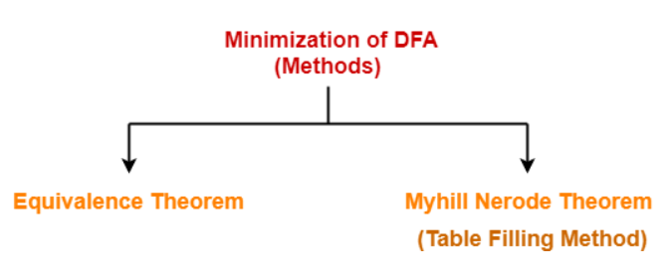
Contd…

Slide 16
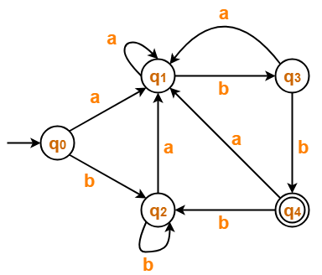


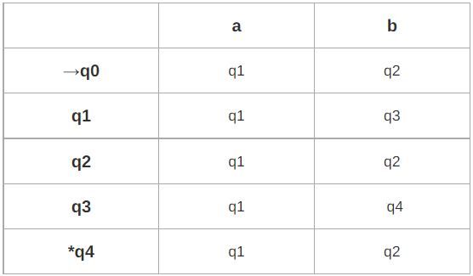


Equivalence Theorem-Example 1
Using equivalence theorem, we have
0 equivalence
1 equivalence
2 equivalence
3 equivalence
Since P₃=P₂, we stop.

Slide 17
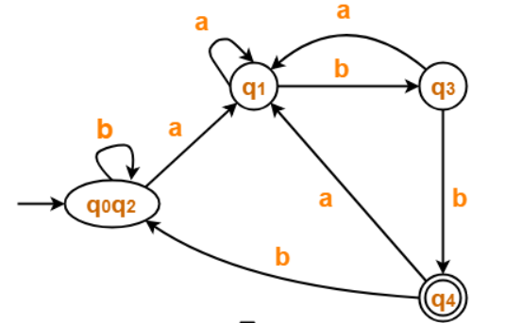
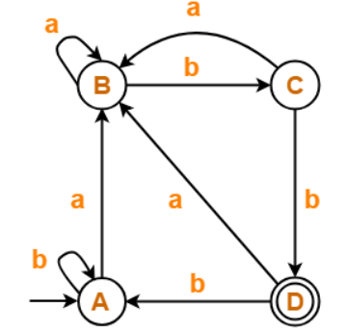

Contd…

Slide 18
Equivalence Theorem-Example 2
Using equivalence theorem, we have
0 equivalence
P₀={q₀, q₁, q₃, q₄, q₅, q₆, q₇} {q₂}
1 equivalence
P₁={q_{0,} q₄, q₆} { q₁, q₇} {q₃, q₅} {q₂}
2 equivalence
P₂={q_{0,} q₄} {q₆} { q₁, q₇} {q₃, q₅} {q₂}
3 equivalence
P₃={q_{0,} q₄} {q₆} { q₁, q₇} {q₃, q₅} {q₂}
Since P₃=P₂, we stop.
 | 0 | 1
→q₀ | q₁ | q₅
q₁ | q₆ | q₂
*q₂ | q₀ | q₂
q₃ | q₂ | q₆
q₄ | q₇ | q₅
q₅ | q₂ | q₆
q₆ | q₆ | q₄
q₇ | q₆ | q₂

Slide 19
Contd…
 | 0 | 1
→{q₀ ,q₄} | {q₁, q₇} | {q₃, q₅}
{q₆} | {q₆} | {q₀ ,q₄}
{q₁, q₇} | {q₆} | {q₂}
{q₃, q₅} | {q₂} | {q₆}
*{q₂} | {q₀ ,q₄} | {q₂}

Slide 20
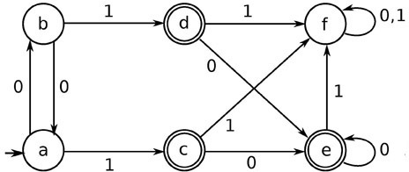
Equivalence Theorem-Example 3 (More than one final states)
Using equivalence theorem, we have
0 equivalence
P₀={a, b, f} {c, d, e}
1 equivalence
P₁={a, b} {f} {c, d, e}
2 equivalence
P₂={a, b} {f} {c, d, e}
Since P₂=P₁, we stop.
 | 0 | 1
→a | b | c
b | a | d
*c | e | f
*d | e | f
*e | e | f
f | f | f
 | 0 | 1
→{a,b} | {a,b} | {c,d,e}
{f} | {f} | {f}
*{c,d,e} | {c,d,e} | {f}

Slide 21
Equivalence Theorem – Example 4 When there are unreachable states involved
A state is said to be unreachable if there is no way it can be reached from the initial state.
 | 0 | 1
→A | B | C
*B | D | E
*C | E | D
D | G | G
E | G | G
F | D | E
*G | G | G
Unreachable state

Slide 22
Contd…
 | 0 | 1
→A | B | C
*B | D | E
*C | E | D
D | G | G
E | G | G
*G | G | G
Using equivalence theorem, we have
0 equivalence
P₀={A,D,E} {B,C,G}
1 equivalence
P₁= {A,D,E} {B,C}{G}
2 equivalence
P₂={A} {D,E} {B,C} {G}
3 equivalence
P₃={A} {D,E} {B,C} {G}
Since P₃=P₂, we stop.
 | 0 | 1
→{A} | {B,C} | {B,C}
{D,E} | {G} | {G}
*{B,C} | {D,E} | {D,E}
*{G} | {G} | {G}

Slide 23
Myhill-Nerode Theorem (Table-Filling Method)
Input: DFA
Output: Minimized DFA
Steps:
Draw a table for all pairs of states (P,Q)
Mark all pairs where P ∈ F and Q ∉ F
If there are any unmarked pairs (P,Q) such that [δ(P,x),δ(Q,x)] is marked, then mark [P,Q] where ‘x’ is an input symbol
Repeat this until no more markings can be made
Combine all the unmarked pairs and make them a single state in the minimized DFA.

Slide 24
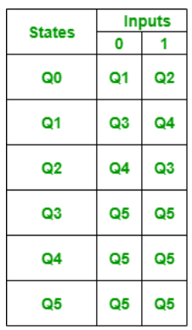
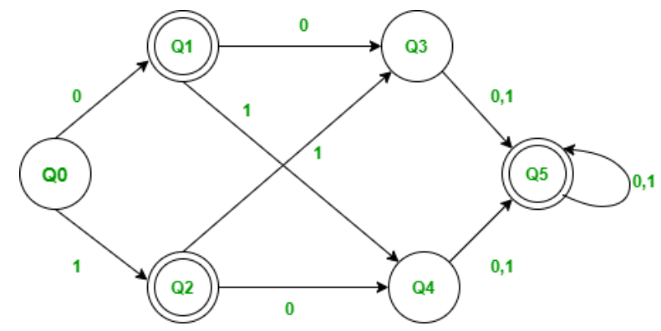
Table-Filling Method-Example 1

Slide 25
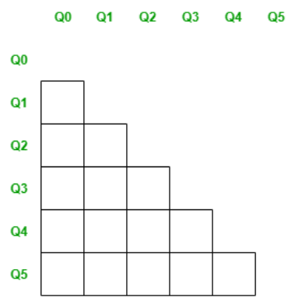
Contd…
Step-1: Create the pairs of all the states involved in DFA.

Slide 26
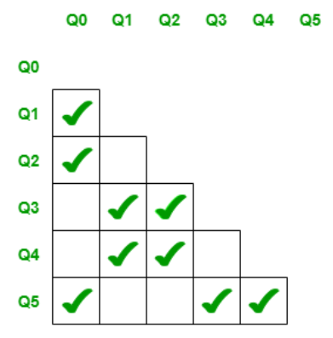
Step 2: Mark all pairs where P ∈ F and Q ∉ F

Slide 27
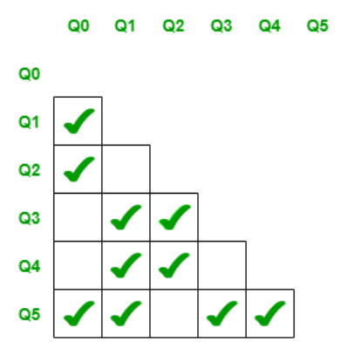
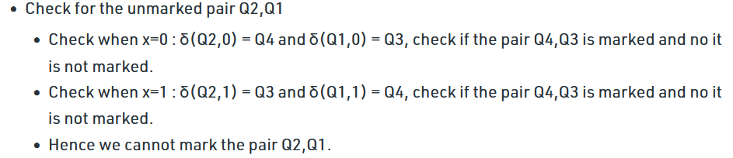

Contd…
Step 3: If there are any unmarked pairs (P,Q) such that [δ(P,x),δ(Q,x)] is marked, then mark [P,Q] where ‘x’ is an input symbol
Repeat this until no more markings can be made

Slide 28
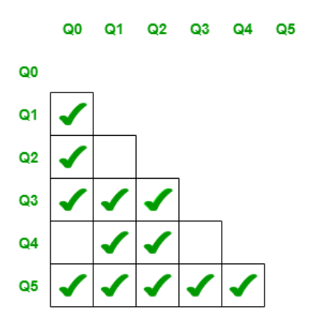

Contd…
Continued Step 3.

Slide 29
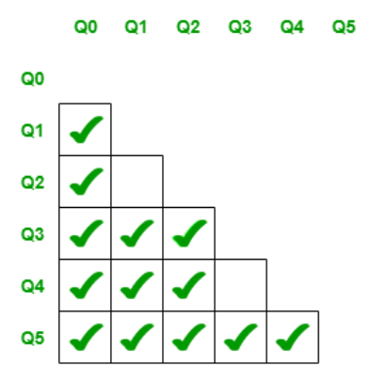
Contd…
Continued Step 3.

Slide 30
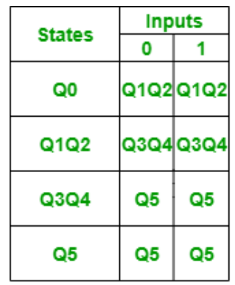
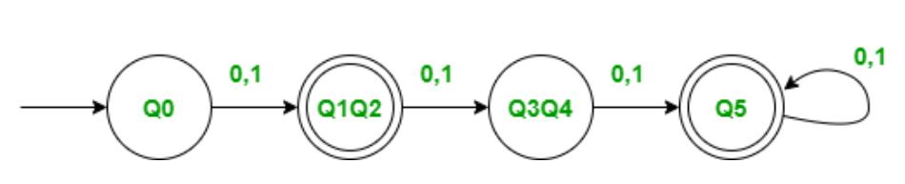
Contd…
Step 4: Combine all the unmarked pairs and make them a single state in the minimized DFA.

Slide 31
Table Filling Method- Example 2
0
1
0
1
0
a
b
c
d
b
1
0
1
0
1
1
1
0
e
f
g
h
c
1
0
d
0
Initialize table entries:
Unmarked, empty list
e
f
g
h
a
b
c
d
e
f
g

Slide 32
Contd…
0
1
0
1
0
a
b
c
d
b
1
0
1
0
1
1
1
0
e
f
g
h
c
1
0
d
0
Mark pairs of final &
nonfinal states
e
f
g
h
a
b
c
d
e
f
g

Slide 33
Contd…
0
1
0
1
0
δ(b,0) ≡? δ(a,0)
δ(b,1) ≡? δ(a,1)
a
b
c
d
b
1
0
1
0
1
1
1
0
e
f
g
h
c
1
0
d
0
For each unmarked
pair & symbol, …
e
f
g
h
a
b
c
d
e
f
g

Slide 34
Contd…
0
1
0
1
0
g ≡? b
c ≡? f
Maybe.
No!
a
b
c
d
b
1
0
1
0
1
1
1
0
e
f
g
h
c
1
0
d
0
For each unmarked
pair & symbol, …
e
f
g
h
a
b
c
d
e
f
g

Slide 35
Contd…
0
1
0
1
0
a
b
c
d
b
1
0
1
0
1
1
1
0
e
f
g
h
c
1
0
d
0
For each unmarked
pair & symbol, …
e
f
g
h
a
b
c
d
e
f
g

Slide 36
Contd…
0
1
0
1
0
δ(e,0) ≡? δ(a,0)
δ(e,1) ≡? δ(a,1)
a
b
c
d
b
1
0
1
0
1
1
1
0
e
f
g
h
c
1
0
d
0
For each unmarked
pair & symbol, …
e
f
g
h
a
b
c
d
e
f
g

Slide 37
Contd…
0
1
0
1
0
h ≡? b
f ≡? f
Maybe.
Yes.
a
b
c
d
b
1
0
1
0
1
1
1
0
e
f
g
h
c
1
0
d
0
For each unmarked
pair & symbol, …
e
f
g
h
(a,e)
a
b
c
d
e
f
g

Slide 38
Contd…
0
1
0
1
0
a
b
c
d
b
1
0
1
0
1
1
1
0
e
f
g
h
c
1
0
d
0
For each unmarked
pair & symbol, …
e
f
(g,a)
g
(g,a)
h
(a,e)
a
b
c
d
e
f
g

Slide 39
Contd…
0
1
0
1
0
a
b
c
d
b
Need to mark.
1
0
1
0
1
So, mark (g,a) also.
1
1
0
e
f
g
h
c
1
0
d
0
For each unmarked
pair & symbol, …
e
f
(g,a)
g
(g,a)
h
(a,e)
a
b
c
d
e
f
g

Slide 40
Contd…
0
1
0
1
0
a
b
c
d
b
1
0
1
0
1
1
1
0
e
f
g
h
c
1
0
d
0
For each unmarked
pair & symbol, …
e
f
(g,a)
g
h
(a,e)
a
b
c
d
e
f
g

Slide 41
Contd…
0
1
0
1
0
a
b
c
d
b
1
0
1
0
1
1
1
0
e
f
g
h
c
1
0
d
0
Combine all unmarked
pairs of states.
e
f
0
1
0
1
g
a ≡ e
b ≡ h
d ≡ f
ae
bh
c
1
0
0
h
1
(a,e)
1
df
g
0
a
b
c
d
e
f
g

Slide 42
Contd…
0
1
0
1
0
a
b
c
d
b
1
0
1
0
1
1
1
0
e
f
g
h
c
1
0
d
0
Delete unreachable
states.
e
f
0
1
0
1
g
ae
bh
c
None.
1
0
0
h
1
(a,e)
1
f
g
0
a
b
c
d
e
f
g

Slide 43
Questions?

